Slide 1
Lunch and Learn – Business Cases

Slide 2
Agenda
What is the point of a business case?
Importance of the process & link to Root Cause analysis
The GSTT Process
Tips & what to look out for?
Q&A

Slide 3
What is the point of a business case?
To summarise what the project wants the Board to approve
A governance tick box
To provide a paper trail / audit trail of our decisions
To stop spending money on unnecessary things
A way to delay approving projects to reduce spend
To provide an overview of a scheme
I don’t know
Something NHSE makes us do
To make sure the correct people have signed it off
To understand if it (the project) makes money or not

Slide 4
What is the point of a business case?
To summarise what the project wants the Board to approve
To provide a paper trail / audit trail of our decisions
To stop spending money on unnecessary things
To provide an overview of a scheme
To understand if it (the project) makes money or not
To make sure the correct people have signed it off

Slide 5
What is the point of a business case?
Some valid observations
Most answers concentrated on the “decision making” audit trail and getting correct sign offs which is important
Also discussed the way it summarises information for Boards to make a decision for projects to go ahead which again is important.
One bit that was missed was the role in actually defining what the problem is and creating the optimum solution.

Slide 6
Why are business cases important?
To ensure projects have been properly scoped, planned and cost justified from the outset.
To ensure a project has evaluated and assessed all available options
To justify the project in terms of costs and benefits and determine whether the project is worthwhile and solves a problem
To ensure the project is aligned with Trust strategy (incl. EDI, HR, environmental)
To enable the Trust and its key stakeholders to understand, influence and shape the project’s scope and direction early on in the planning process
To provides internal staff, decision makers and stakeholders with a management tool for evidence based, transparent decision making
To provide a framework for the delivery, management and performance monitoring of the resultant scheme.

Slide 7
What qualities does a good business case have?
Needs to be seen as both a product and a process. The business case process guides the thinking and provides steers and prompts to help projects make the right conclusions.
The Business Case should be used as a living document, to be updated regularly as information and assumptions are developed and refined prior to each key decision point
It provides decision makers with the evidence to make an informed decision in the best interests of the organisation
Creates a framework for the delivery, management and performance monitoring of the resultant scheme.
It is not just to be provided for ideas of getting approval and then organised.
Shouldn’t be the case that a solution or decision is made and then the business case is done retrospectively.

Slide 8
5 reasons for doing a project:
Economy
Improving throughput and unit costs
Effectiveness
Re-procurement (provision of new service or re-provision of expiring contract)
Statutory compliance

Slide 9
5 reasons for doing a project:
Economy
Improving throughput and unit costs
Effectiveness
Re-procurement (provision of new service or re-provision of expiring contract)
Statutory compliance
Business Case will be required
May not require a business case

Slide 10
Business Cases and links to Root Cause analysis
In order to produce a robust and clear business case, the project needs a clear understanding of the existing arrangements and its related problems and opportunities
A key component (if not, THE key component) is to quantify “Where do things stand now?”
i) What is happening now vs. what you want or needs to be happening?
ii) What facts or data indicate there is a problem?
iii) Why do they exist?
iv) What is (are) their cause(s)?

Slide 11
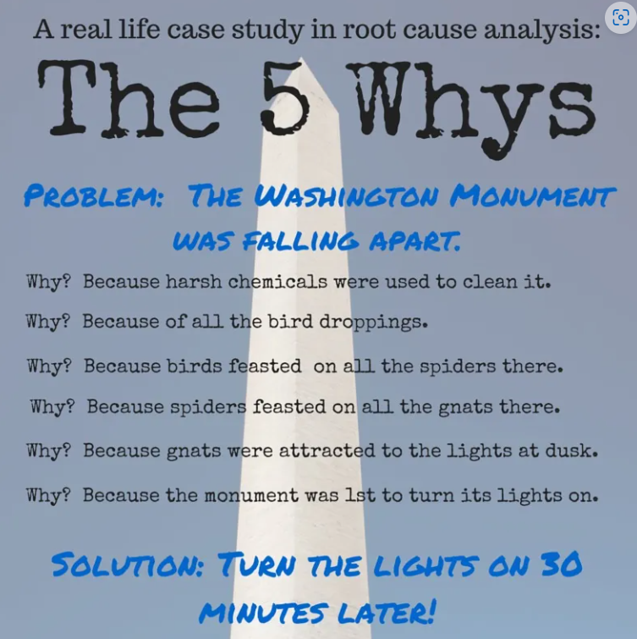
Root Cause Analysis - Real Life Example
A famous example of why Root Cause Analysis is so important. In May 1990, a 50 lb. block of marble fell from the top of a column in the Jefferson memorial. Professional consultants were brought in by the National Park Service to investigate why.
Some of the story may have been slightly exaggerated but it was true that the overall cleaning process was found to be a significant issue in the erosion and it is an accepted fact the light attracts gnats and midges which were eaten by spiders.
The initial 6 week pilot program during which the lights around the memorials were turned on one hour after sunset on Mondays, Wednesdays and Fridays resulted in an 85% reduction in midge infestation & 50% less cleaning time.
The point: Understanding of the root causes of our problems can yield simpler, more effective, and less costly solutions.

Slide 12
Importance of Root Cause Analysis
Problem
We don’t have enough Acute medical beds
Solution
Build / Refit 3 x new acute medical wards and increase staffing appropriately using existing ward staffing mix.
Improved KPI
Reduction in bed utilisation
A&E target improvement
Business Case agreed
Capital cost - £25m
Revenue cost - £2m pa

Slide 13
Importance of Root Cause Analysis
Poor performance
KPI
We don’t have enough Acute Medical Beds
What is the problem?
Acute medical patients are spending unnecessary time in hospital beds
Root Causes
Infrequent consultant ward rounds
Communication between ward and social care
Therapy not administered early enough
Duplication of assessments and discharge checklists
Solution
Job Plan review
Review MDT working
Review links between partner organisations
Define skill mix on wards
Review discharge checklists
Improved KPI
Reduction in bed utilisation
A&E target improvement
Capital cost - zero
Revenue cost - £600k pa
Cause is not the same as Effect
It is important to tackle the root cause of a problem in order to solve it – tackling the effects is just like treating the symptoms
A fixated view on fixing the ‘symptom’ may solve today’s problem, but it’s at best a short term solution
Tackling the root cause will have the most impact on your KPIs in the long term

Slide 14
Types of Business Case and the GSTT process

Slide 15
The 5 Case Model
The Five Case Model is the approach for developing business cases recommended by HM Treasury. It consists of the following:
The Strategic Case - Makes the case for change – a clear rationale for intervention - and demonstrates it provides strategic fit.
The Economic Case – Where options are appraised to identify what delivers best public value to society.
The Commercial Case - Demonstrates that the preferred option will result in a viable procurement and a well structured deal that is commercially viable
The Financial Case - Demonstrate the affordability and funding of the preferred option
The Management Case – Describes how the proposal will be developed successfully via robust arrangements for the delivery, monitoring and evaluation of the scheme

Slide 16
Different types of business case
Concept Case
Strategic Outline Case (SOC)
Outline Business Case (OBC)
Short Form Business Case (SFBC)
Full Business Case (FBC)

Slide 17
Concept case
A GSTT specific process brought into place in June 2023
Similar to a Business Justification Case
This is the first template to complete for any new idea and will be used to inform the first stage of prioritisation.
Provides a brief overview on the scheme and confirmation that the clinical group deems it a priority
Aim is to avoid large amounts of time (and cost) on writing long cases that may not make it onto medium term capital plan.
Will be reviewed and added to database or “hopper”. At annual planning, those Concept Cases deemed to be a Trust priority will be asked to work the scheme up to SOC

Slide 18
Strategic Outline Case (SOC)
Sets out the questions the OBC is to answer
Provides strategic context and confirms fit
Makes case for change -> highlights the issue and why it’s a problem
Develop a long list of solutions followed by agreed Shortlist.
Shortlist should be minimum of 4 options: Do Nothing, Do Minimum, Preferred Way (s) Forward and Do maximum
Indicates probable costs, benefits and risks
Outlines delivery arrangements
Emphasis is on the Strategic and Management cases

Slide 19
Outline Business Case (OBC)
The biggest piece of work – takes most time and arguably the most important
Revisits the case for change
Appraises the shortlist from SOC and comes up with singular preferred option.
Confirms procurement strategy, potential deal and affordability
Needs detailed financial modelling of the impacts
Identifies resources and management arrangements to ensure successful delivery
Identifies the option which best optimises balance of public value (cost, benefits and risk) to the UK (Net Present Social Value)

Slide 20
Short Form Business Case (SFBC)
For lower value schemes and those that come “fully funded” by external parties such as the charity or national bodies.
This is a condensed version of an OBC and requires less information and therefore takes less time
The key is that – even for “fully funded” schemes – we have performed enough work to understand the long term impacts and how the projects affect other parts of the organisation.

Slide 21
Full Business Case (FBC)
“Update and polish” of OBC
Confirms all plans and highlights if anything has changed since OBC
Usually will have tenders back and therefore more robust financial estimates.
Outlines contractual arrangements for the deal and work is focussed on Commercial Case.
Confirms affordability and the plans for successful delivery.
Provides a “Final version of the Truth”. The document to refer back to during delivery.
Confirms public value and that the most economically advantageous offer is being procured

Slide 22
Timeline of Business Cases
Decision to add to capital plan
Decision to undertake appraisal of shortlist
Decision to proceed with procurement
Decision to contract and set up project team
Concept Case
Strategic Outline Case
Outline Business Case
Full Business Case
Shortlist:
Do Nothing
Do Minimum
Preferred
Do maximum
Preferred Option
Confirmed Preferred Option

Slide 23
There are five routes to access capital funding
A block of capital is allocated to each area (block allocations) in the medium term capital plan. Each route then has its own defined process to prioritise within the allocation
Capital planning and prioritisation
Background to prioritisation
Maintaining & replacing existing assets – resilience and replacement
New developments
Area
Definition | Routine replacement of end of life medical equipment (including minor estates works required to implement those replacements), in order to maintain service capacity and capability. This does not include the procurement of additional equipment, or to increase the existing fleet of equipment, which should be resourced from the Delivery Group Block Allocation. | Routine physical estates works to ensure that the Trust’s building and engineering infrastructure is demonstrably reliable, fit for purpose, resilient and safe. This does not include schemes to improve service capacity or capability, which happen to have a significant estates element. Those schemes should be resourced from the Delivery Group Block Allocation. | Upgrade or replace of end of life digital infrastructure. It covers the like for like upgrade of clinical and non-clinical systems where there is no change in functionality or changes to the hardware specifications. It also includes the break/fix of current infrastructure. This includes schemes to digitise processes which are currently manual, or managed utilising low tech software. | Routine physical refurbishment of Theatres and Cath Labs, in order to maintain service capacity and capability. This does not include medical equipment, which should be resourced from the Medical Equipment Block Allocation. Nor does it include schemes to increase the capacity of Cath Labs or Theatres, which should be resourced from the Delivery Group Block Allocation. | All schemes which are not covered by other blocks (including service change or development) and not classified as a Trust major programme. Will require business cases approved by IPB
Medical Equipment Replacement
Estates Backlog Maintenance
Digital Maintenance and Cyclical Upgrade
Theatres and Cath Labs Refurbishment
Delivery Group Strategic Priorities

Slide 24
Top tips & What to look for?

Slide 25
Top tips
Don’t make it too long or verbose! Keep to the critical detail - If it doesn’t add value to the reader then don’t need it in. i.e Do the GSTT board need to know that GSTT is an organisation across 4 sites with a global reputation and turnover of £2bn+?
Try and keep to a consistent style. Having one overall business case writer / owner is useful…Has to be owned by the Trust – not external consultants and not temporary staff. External support is valuable for certain aspects but the responsibility and ownership should remain within the Trust.
Show you understand the current state, and the problem the Business Case is addressing. Is there already a known risk on our risk register? Can we reference it? Have there been SIRIs associated?
Ensure you are involved as early as possible – ideally from the outset. If you do not feel comfortable signing off the finance case or if told “it’s not ready for Finance review” – challenge or escalate!
What dependencies will be needed across the organisation? Does this impact IT, Estates, Comms?
Ensure we have properly looked at alternative options and keep an open mind. Often the initial solution we’ve identified may not be the optimal one. How does the solution directly fix the problem?
Avoid coming to the solution first then retrofitting the analysis

Slide 26
What to look for in Finance Cases
Have Capital charges been accounted for? PDC Dividends, depreciation. Typically add 8-10% onto our capital costs.
Have Lifecycle costs been accounted for? Especially important if charity funded!
Have staffing costs been included – including Essentia, Dti ?
Are financial assumptions such as Inflation consistent with our LTFM?
Have all associated costs outside of immediate project been captured – Decant, Infrastructure upgrades, loss of income if closing a space for works etc
Has a request for resource to move to next step been performed and critically reviewed?
What is the impact on Cash? Cashflow forecasts are key!
Remember - sometimes the business case may not have a compelling finance case but it is still a good thing to do. The key is to spell that out so the Board can make an informed and transparent decision.

Slide 27
Other places where finance can add value
Have monetisable benefits been calculated correctly? They need to be incremental to Do Nothing position and be consistent with our financial assumptions
Have the project team missed any financial benefits? Are there further advantages they haven’t captured nor thought of in their process?
Suggesting alternative solutions and options that may be better for the project.
Ensure challenging of requirements to build an OBC / FBC.

Slide 28
Further Information
A number of people have been put forward to take Better Business Course training. Please do it!
Anyone else is interested please contact me and we could review how many licenses are unused and could potentially be re-allocated
Gti page: Business Case Templates
Plenty of literature and articles about the importance of business cases across the web.
Free public documents ->
Green Book guidance on public sector business cases using the 'five case model' (england.nhs.uk)
Guide to developing the Programme Business Case (publishing.service.gov.uk)

